Slide 1
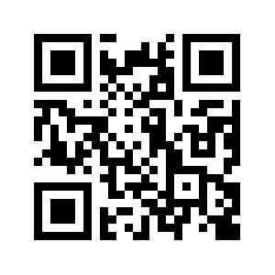

Does It Matter Who Said It? Exploring the Impact of Deepfake Profiles On User Perception towards Disinformation
Margie Ruffin, Haeseung Seo, Aiping Xiong, Gang Wang
https://mruffin.github.io
Notes:
Hello everyone,
Margie Ruffin
3rd yr phd student in CS
Does it matter who said it? Exploring the impact of deepfake profiles on user perception towards disinformation

Slide 2
Deepfake profiles are on the rise in social media…
Social Media has been plagued by disinformation campaigns
Most of these “fake” profiles have been easy to spot
Research shows, that’s not the case anymore
Notes:
For the past few years social media platforms have been plagued by disinfo campaigns. Threat actors often create fake personas to help promote false information and usually these fake profile are easy to spot
However, prior work shows that these fake profiles are getting harder and harder to detect.
Malicious actors are creating “Deepfake” profiles using high-quality synthesized media content such as images, text, audio, and video to use on Twitter, Facebook and LinkedIn

Slide 3
Deepfake profiles are on the rise in social media…
Social Media has been plagued by disinformation campaigns
Most of these “fake” profiles have been easy to spot
Research shows, that’s not the case anymore
What does this mean for the users of social media?
Notes:
I invite you to think as I go on, what this could mean for social media users, especially those who trust these platforms to provide them with up-to-date and accurate news

Slide 4
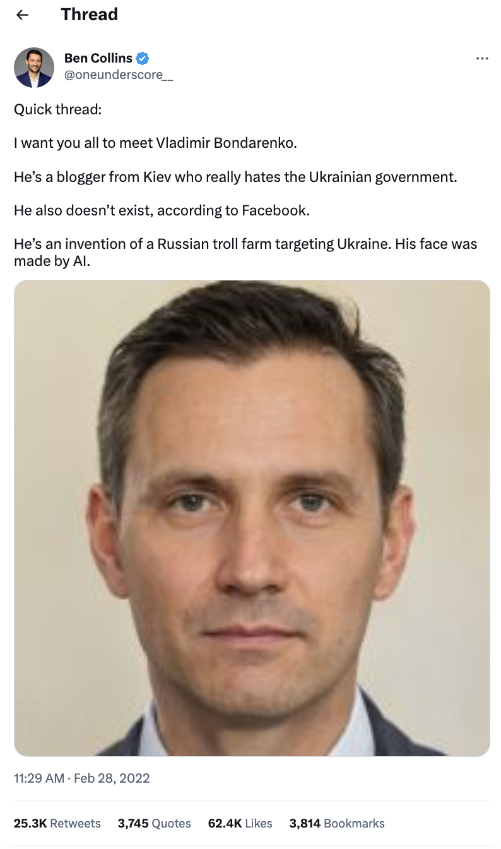
Quick Thread:
I want you all to meet Valdimir Bondarenko.
He’s a blogger from Kiev who really hates the Ukrainian Gov.
He also doesn’t exist, according to Facebook.
He’s an invention of a Russian troll farm targeting Ukraine. His face was made by AI.
Aparna Banerjea. Digital war: How russia is using deep fakes in ukraine for propaganda. Business Today, 2022. https://www.businesstoday.in/latest/world/story/digital-war-how-russia-is-using-deep-fakes-in-ukraine-for-propaganda-324531-2022-03-02.
Notes:
Deepfake profiles have been used in numerous cases, including this one. In this tweet we can see an image of a person. The text reads…
A profile was made using this deepfaked photo to spread a false narrative during the recent Ukraine-Russian War.
We are seeing that threat actors create profiles to impersonate bloggers/ journalists to seem more credible to their audience.

Slide 5
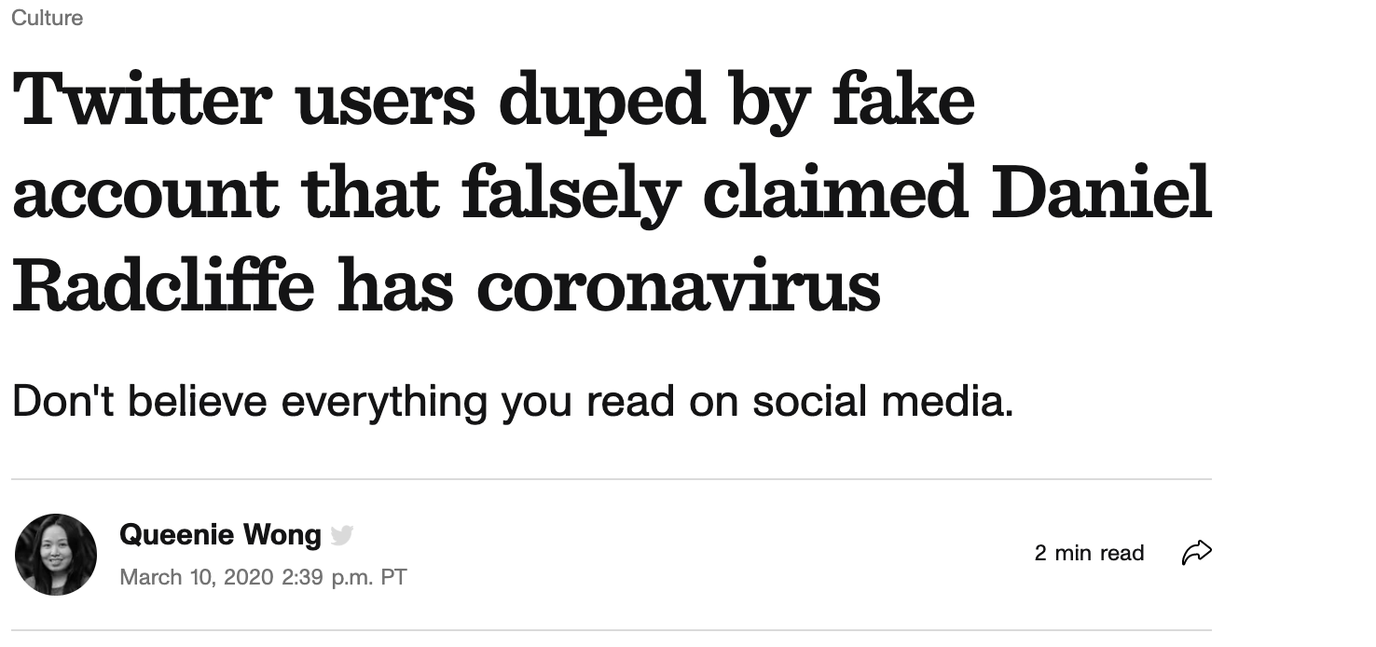
[1] Aparna Banerjea. Digital war: How russia is using deep fakes in ukraine for propaganda. Business Today, 2022. https://www.businesstoday.in/latest/world/story/digital-war-how-russia-is-using-deep-fakes-in-ukraine-for-propaganda-324531-2022-03-02.
[2] Queenie Wong. Twitter users duped by fake account that falsely claimed daniel radcliffe has coronavirus. CNET, Mar 2020. https://www.cnet.com/culture/twitter-users-duped-by-fake-account-that-falsely-claimed-daniel-radcliffe-has-coronavirus/.
Notes:
Another example of someone using a fake profile to fool social media users, comes from another fake account.
We have also seen accounts take on personas mimicking health professionals or organizations to seem more credible to social media users.

Slide 6
[1] Aparna Banerjea. Digital war: How russia is using deep fakes in ukraine for propaganda. Business Today, 2022. https://www.businesstoday.in/latest/world/story/digital-war-how-russia-is-using-deep-fakes-in-ukraine-for-propaganda-324531-2022-03-02.
[2] Queenie Wong. Twitter users duped by fake account that falsely claimed daniel radcliffe has coronavirus. CNET, Mar 2020. https://www.cnet.com/culture/twitter-users-duped-by-fake-account-that-falsely-claimed-daniel-radcliffe-has-coronavirus/.
Notes:
In our study we focus on the Twitter platform because it has been one of the most targeted platforms by disinfo campaigns and deepfake profiles.
We also focus on news stimuli related to COVID-19 because of the large amount of disinformation that has been and still disseminated.

Slide 7
We want to know: Do profiles alter perceptions?
RQ1: Do participants increase their perceived accuracy of tweets if deepfake profiles were also presented compared to showing the tweets only?
RQ2: Do participants increase their engagement with the tweets if deepfake profiles were also presented compared to showing the tweets only?
RQ3: Compared with other types of fake profiles, are deepfake profiles harder to detect by participants? What are the primary factors that participants consider when assessing the profiles?
Notes:
Our study aims to answer 3 research questions.
On your Twitter News Feed, you can only see the name, profile photo, and handle of tweet posters. Given that, our first questions wanted to explore whether seeing the profile of the tweet author will affect whether users believe in the accuracy of a tweet.

Slide 8
We want to know: Do profiles alter perceptions?
RQ1: Do participants increase their perceived accuracy of tweets if deepfake profiles were also presented compared to showing the tweets only?
RQ2: Do participants increase their engagement with the tweets if deepfake profiles were also presented compared to showing the tweets only?
RQ3: Compared with other types of fake profiles, are deepfake profiles harder to detect by participants? What are the primary factors that participants consider when assessing the profiles?
Notes:
We want to also measure whether or not the likelihood of engagement, if someone will like, reply, retweet, etic, is affected by showing the users the tweet authors profiles or not.

Slide 9
We want to know: Do profiles alter perceptions?
RQ1: Do participants increase their perceived accuracy of tweets if deepfake profiles were also presented compared to showing the tweets only?
RQ2: Do participants increase their engagement with the tweets if deepfake profiles were also presented compared to showing the tweets only?
RQ3: Compared with other types of fake profiles, are deepfake profiles harder to detect by participants? What are the primary factors that participants consider when assessing the profiles?
Notes:
And lastly, we want to know which profile type appears more authentic/ harder to identify and why?

Slide 10
3 Conditions
3 Tweets
Experiment Design
Tweet 1: “The Centers for Disease Control and Prevention has amassed the largest collection of human DNA data in history through COVID-19 PCR tests.”
Tweet 2: “On Dec. 28, 2021, three days before her death, Betty White said ‘Eat healthy and get all your vaccines. I just got boosted today.”
Tweet 3: “There’s a positive correlation between higher mask usage and COVID-19 deaths.”
Q1: Information accuracy
Q2: Engagement
Q3: Profile authenticity
Q4: Profile features
Q5: Recollection
Q6: Reason to engage
Deepfake
Organization
Simplefake
x2
Notes:
In our study we include the use of 3 profile conditions. A deepfake profile (This profile is that of a person with social credibility or authority, like a journalist)
We include an Organization profile with a health focus, which represents a profile that would likely have accurate knowledge concerning COVID-19
And lastly, a Simplefake profile which is representative of a fake profile that puts little to no effort into the appearance of it. ( a bot profile)

Slide 11
3 Conditions
3 Tweets
Experiment Design
Tweet 1: “The Centers for Disease Control and Prevention has amassed the largest collection of human DNA data in history through COVID-19 PCR tests.”
Tweet 2: “On Dec. 28, 2021, three days before her death, Betty White said ‘Eat healthy and get all your vaccines. I just got boosted today.”
Tweet 3: “There’s a positive correlation between higher mask usage and COVID-19 deaths.”
Q1: Information accuracy
Q2: Engagement
Q3: Profile authenticity
Q4: Profile features
Q5: Recollection
Q6: Reason to engage
Deepfake
Organization
Simplefake
x2
Notes:
We have 3 tweets that each study participant sees along with each profile type. These tweets were crafted from fake news gathered from Fact-checking websites such as
Snopes, poltifact, and Fact-Checking.com

Slide 12
3 Conditions
3 Tweets
Experiment Design
Tweet 1: “The Centers for Disease Control and Prevention has amassed the largest collection of human DNA data in history through COVID-19 PCR tests.”
Tweet 2: “On Dec. 28, 2021, three days before her death, Betty White said ‘Eat healthy and get all your vaccines. I just got boosted today.”
Tweet 3: “There’s a positive correlation between higher mask usage and COVID-19 deaths.”
Q1: Information accuracy
Q2: Engagement
Q3: Profile authenticity
Q4: Profile features
Q5: Recollection
Q6: Reason to engage
Deepfake
Organization
Simplefake
x2
Notes:
We ask our participants 6 different types questions, throughout the course of our study.
The information accuracy question measures the participants perception of the accuracy of the tweet and the engagement question inquires about which way if any would the participant choose to engage with said tweet, including like, reply, retweet, external share, or no engagement
We then ask participants to rate the authenticity of each profile they saw as well as identify which features helped them to decide whether these profiles were real or not.
In the end, we asked participants to recall whether or not they intended to engage with any of the tweets they saw and to detail an answer why if they did choose to do so

Slide 13
Notes:
Here you can see an example of each profile type, including deepfake, organization, and Simplefake.
Each condition has 3 variations that were randomly shown to participants that included a changing of the photo (except Simplefake), the bio, the name, the handle, and links in the bio

Slide 14
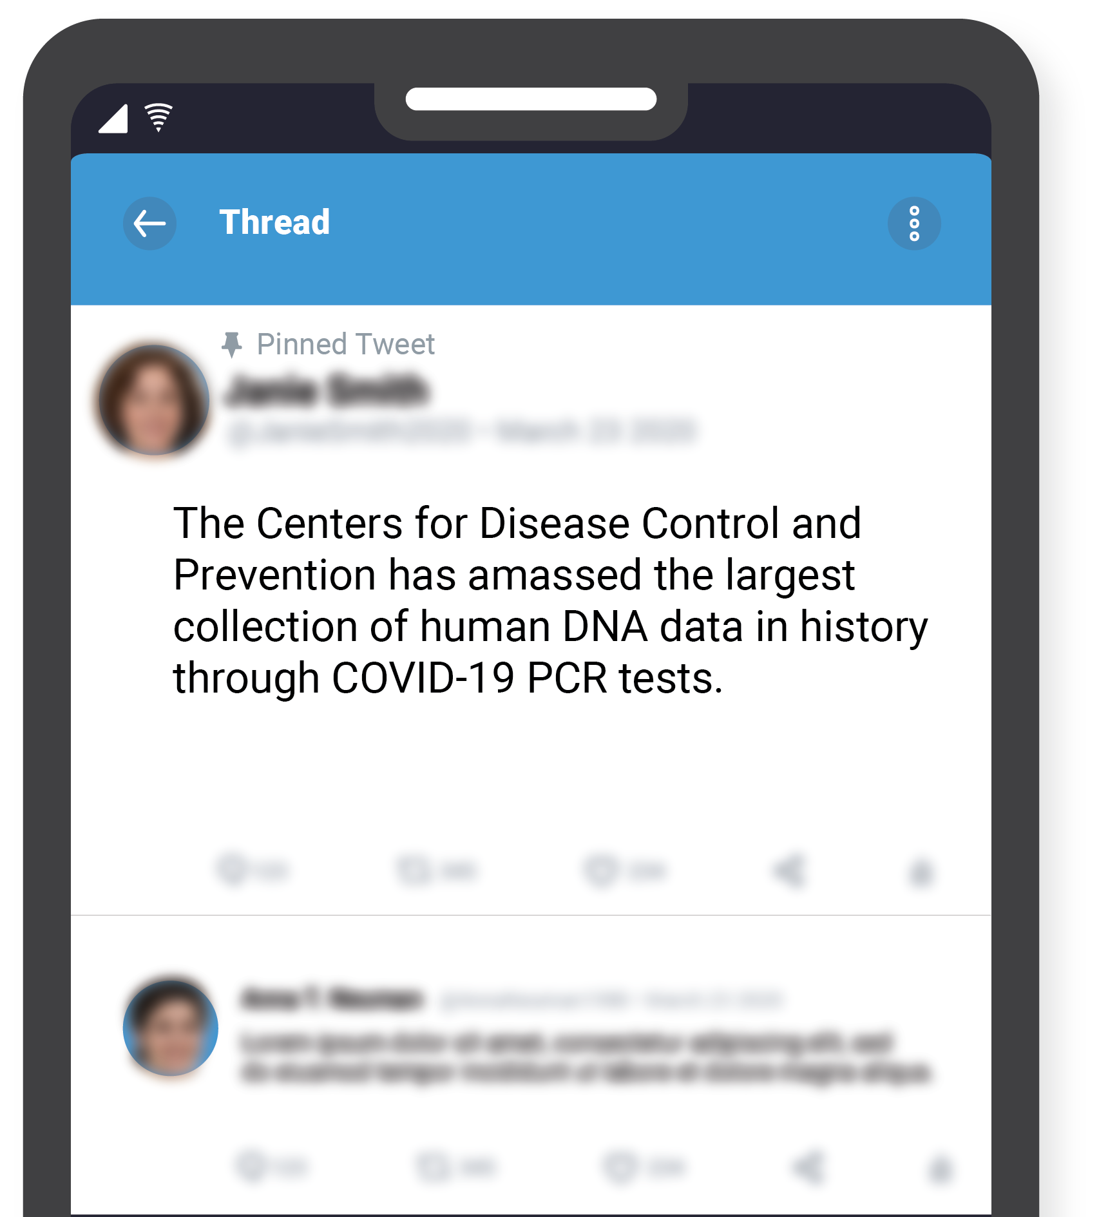
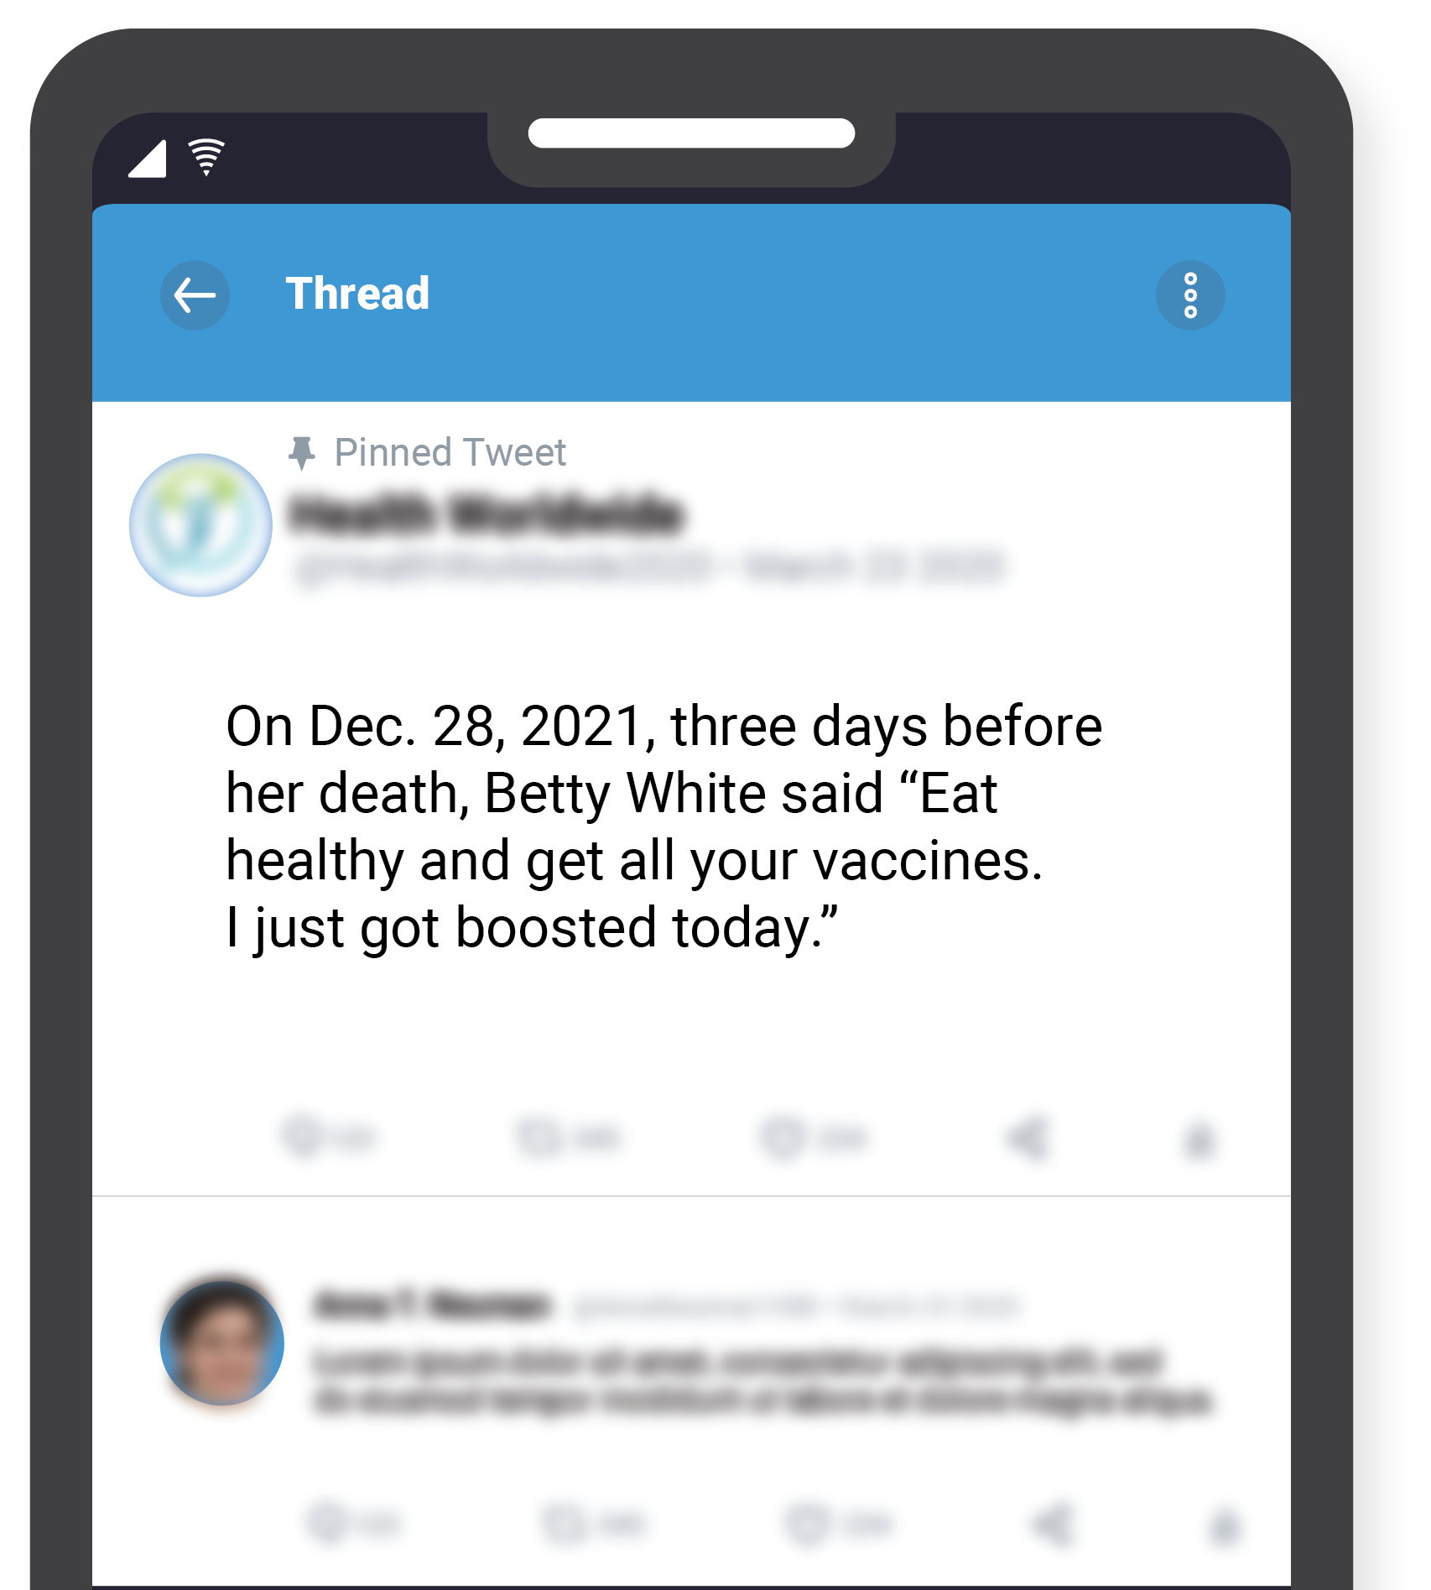
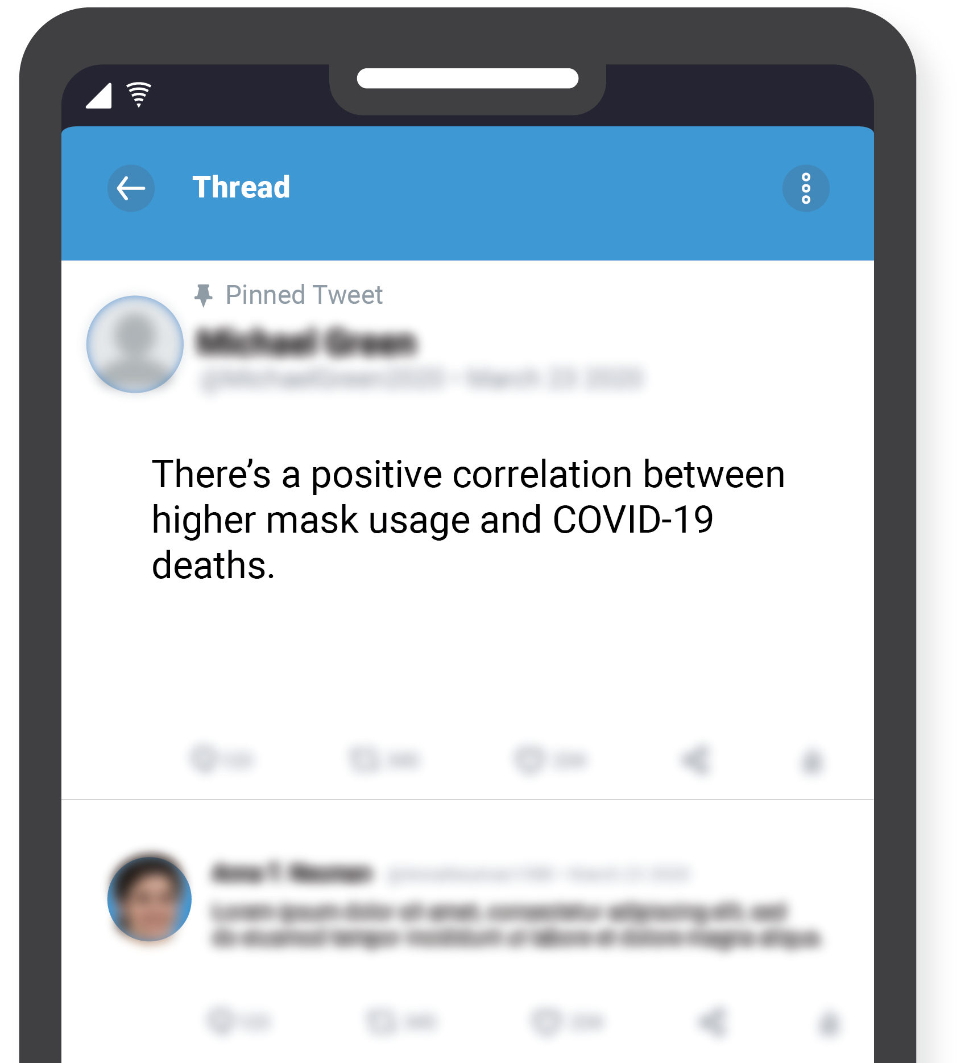
Notes:
Here you can also see the tweets that participants saw during they survey with identifying information blurred to give them a chance to focus on the news stimuli

Slide 15
Notes:
Each participant saw each of the 3 profiles, randomly paired with one of our 3 tweets.
They were asked the information accuracy question and engagement question as they were shown just the tweet, and then asked the same two questions again as they were shown the tweet and the tweet authors profile side by side.

Slide 16
Notes:
After answering those questions they were prompted to rate each of the profiles they saw

Slide 17
Notes:
And finally they were asked to fill out exit questions including demographics, political preference, vaccination status and more

Slide 18
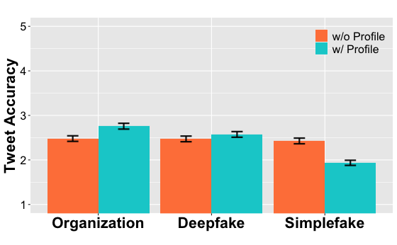
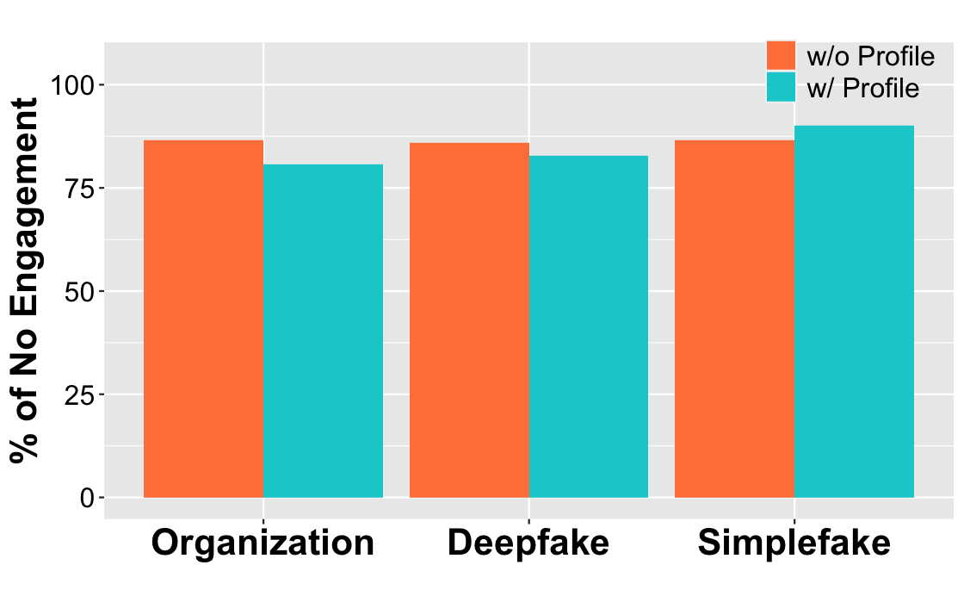
Is it real and where do I go from here…
Figure: Perceived tweet accuracy rating: mean and standard error
Figure: % of Participants who selected
“no engagement” towards the tweet.

Slide 19
What do users have to say about tweet accuracy?
The perceived tweet accuracy is increased when a profile of authority (organization and deepfake) is presented compared with showing the tweet alone.
The perceived accuracy decreases when the presented profile is a simple bot profile.
Notes:
Some of Our results can be seen in the following chart. We can see the perceived accuracy of the tweets is increased when people see the profile along with the tweet. This is true for profiles with credibility or rather some form of social authority.
This is not true for the Simplefake condition. When people saw this profile and tweet combination, they were less likely to believe the tweet was true.

Slide 20
Why do users engage inaccurate tweets?
The engagement of tweet increases when a profile of authority (organization and deepfake) is presented, vs showing the tweet alone.
Engagement decreases when the presented profile is a simple bot profile
Seek more information.
“I have liked some of the tweets I thought were inaccurate to ‘save them’ and go back to the tweet after doing my own research/fact-checking.”
Refute disinformation.
“Sometimes you need to speak some sense into people when they are incredibly wrong”
Notes:
We also see that participants while, majority chose not to engagement with any of the tweets, when they do, they are more likely to once seeing the profile of the tweet poster. They are more likely to like, reply, retweet, or share once seeing who posted it.
This is not true for the simple bot profile.
Upon further analysis and asking users why they would engage with fake news, we found they usually fell into one of two major categories. They wanted to get more information about the posted information or they wanted to publicly refute the information.

Slide 21
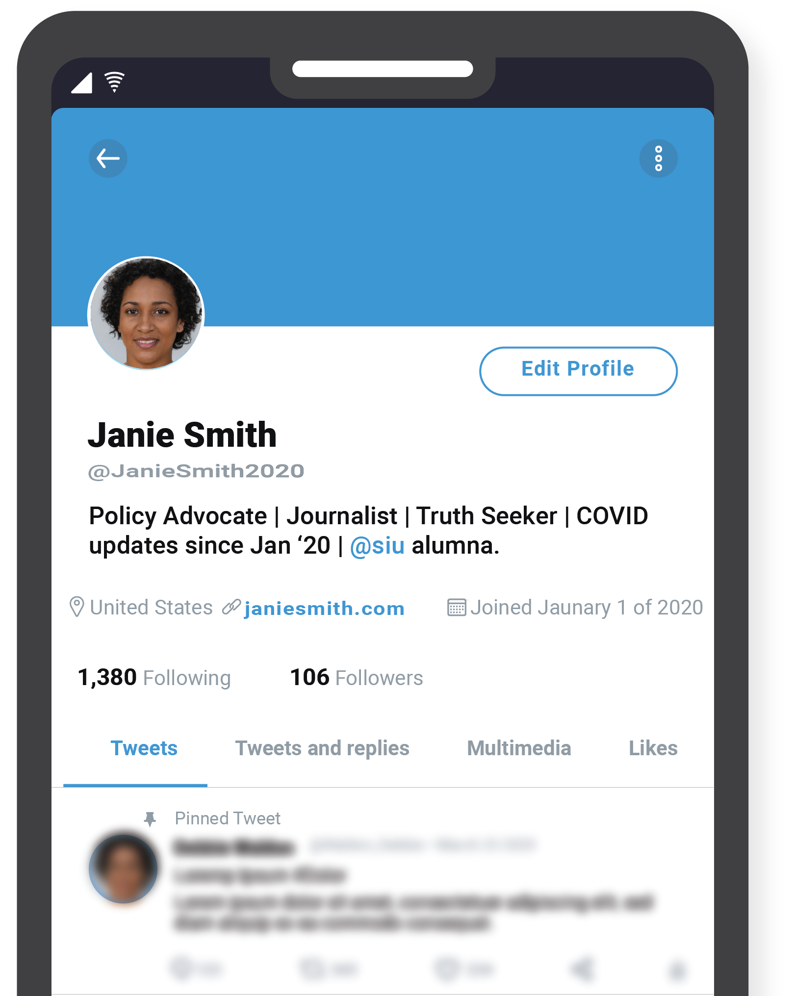
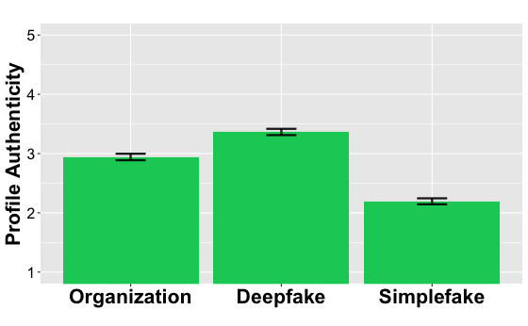
Which profile is the most convincing to viewers?
Notes:
After having users rate the profiles they saw for each condition, we found that the deepfake profile was voted to be the most authentic appearing.
This was surprising because participants also indicated that they believed that information posted by organizations was more accurate.

Slide 22
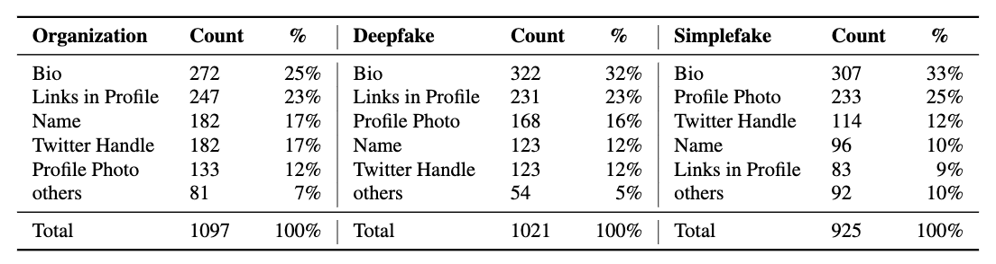
What makes a profile authentic?
Table: The Most Influential Profile Feature—We ask participants to select profile features that influence the information accuracy rating. The total numbers across the three conditions are different because participants can select multiple features per profile.
Notes:
Here you can see what participants relied on most when determining the authenticity of a profile. Across the board the Bio came first.
Unfortunately for social media users, sophisticated AI such as Jasper, ChatGPT, and Bard can make it easy for threat actors to craft a convincing Bio

Slide 23
What makes a profile authentic?
Table: The Most Influential Profile Feature—We ask participants to select profile features that influence the information accuracy rating. The total numbers across the three conditions are different because participants can select multiple features per profile.
Notes:
It was also interesting to find that in profiles of authority, people tend to look for external links in the bio to help prove credibility. In the case of Simplefake profiles, however, a profile photo, or rather a lack thereof is a dead giveaway.

Slide 24
What does this all mean?
Our study shows the significant impact of deepfake profiles on participants’ accuracy rating of and engagement with disinformation
Validates prior work suggesting deepfakes help in social engineering
Users need help in identifying deepfake profiles on social media
Users unintentionally disseminate disinformation in an effort to correct the original poster by retweeting or replying
Alternative methods could be offered to help mitigate this
Notes:
So to tie it altogether, we see that our study provides empirical evidence showing the significant impact of deepfake profiles on participants’ accuracy rating of and engagement with disinformation.
These results help to validate past work while also highlighting the need for mitigating solutions.
We also see that users are unintentionally helping to disseminate disinformation by interacting with it, whether it be for correction or simply to poke fun at it.

Slide 25
+ Future Work
Examine the effects that various combinations of deepfake techniques have on downstream attacks
How sophisticated of an attack can be orchestrated using these techniques
Consider the integration of technical- and human-aspect solutions for deepfake detection and mitigation
Can we teach people how to identify deepfakes (photos, videos, text, etc.)
Notes:
In the future we hope to expand on this work some and explore the effects different combinations of deepfake techniques has on users perception of news.
Currently we are working on a project to train study participants to identify deepfake photos, using a testing and feedback phase methodology.

Slide 26


Summary
Thank You!
The plague of disinformation in social media platforms is worsened by the use of sophisticated deepfake profiles
Users need assistance in identifying such profiles to help curb the spread of false information
Alternative methods of correction by other users are needed for these platforms
Margie Ruffin, Haeseung Seo, Aiping Xiong, Gang Wang
Notes:
Thank You!

